Slide 1
IBM University Engagement Project Submission
“Exploring the Power of Agentic AI with IBM Cloud and Orchestrate”

Slide 2

Project Tile – [Study Coach AI Agent]
Domain of Project – [ Education ]
Student Name | Recent Passport Photo | Email ID | Mobile number [WhatsApp]
Arib Adil Mohammad Fazil |  | aribadil4@gmail.com | 7058265852

Slide 3
Problem Statement -
Problem Statement : Study Coach Agent
The Challenge
Students often struggle with understanding complex concepts, managing study schedules, preparing for exams, and finding reliable learning resources. Educational content is scattered across multiple platforms, making it difficult for learners to receive personalized guidance. Traditional learning systems lack real-time support, adaptive explanations, and interactive study assistance tailored to individual learning needs.
The Objective
Build an AI-Powered Study Coach Agent that provides personalized learning support and academic guidance for students across multiple subjects.
The solution should:
Personalized Study Plans – Create study schedules based on goals, exams, and learning pace.
Knowledge Retrieval (RAG) – Fetch accurate educational content from trusted learning resources.
Concept Explanation – Explain difficult topics in simple and adaptive ways.
Quiz & Assessment Generation – Generate quizzes, mock tests, and flashcards.
Multi-Agent System:
Learning Knowledge Agent
Study Planning Agent
Quiz & Assessment Agent
Progress Tracking Agent
Performance Dashboard – Track learning progress, study hours, and subject-wise performance.

Slide 4
Proposed Solution -
Proposed Solution: AI-Powered Study Coach Agent
The proposed solution is a Multi-Agent AI-Powered Study Coach Agent developed using IBM watsonx.ai, IBM Granite Models, LangFlow, RAG, and IBM Cloud.
The platform acts as an intelligent virtual tutor that helps students learn effectively through personalized guidance, adaptive explanations, and exam preparation assistance.
The system leverages a Retrieval-Augmented Generation (RAG) architecture to retrieve educational content from reliable academic resources, textbooks, documentation, and study materials. Retrieved information is processed by IBM Granite Models to generate accurate and easy-to-understand explanations.
Key Agents
Learning Knowledge Agent
Retrieves academic information from educational resources and explains concepts clearly.
Study Planning Agent
Creates personalized study schedules based on student goals, available study time, and exam dates.
Quiz & Assessment Agent
Generates quizzes, practice questions, flashcards, and mock exams for active learning.
Progress Tracking Agent
Analyzes learning progress, identifies weak areas, and recommends improvement strategies.
Dashboard Features
Subject-wise performance tracking
Learning analytics
Study goal monitoring
Progress visualization
Revision recommendations
The solution combines AI-powered tutoring, assessment generation, personalized planning, and learning analytics into one intelligent educational platform.

Slide 5
Technology Used
LangFlow Platform
Used for visually designing and orchestrating multi-agent workflows.
IBM Granite Models
For reasoning, tutoring, summarization, quiz generation, and personalized learning assistance.
Recommended Model: IBM Granite 4.0 8B Instruct
IBM Cloud
Provides secure, scalable, and reliable infrastructure for deployment.
Retrieval-Augmented Generation (RAG)
Fetches trusted educational content before generating responses, improving accuracy and reducing hallucinations.
IBM watsonx.ai
Used for model deployment, prompt engineering, embeddings, governance, and AI orchestration.
Vector Database (FAISS / ChromaDB)
Stores educational embeddings for fast semantic retrieval.

Slide 6
Orchestrate component Used -
1. Chat Input
Allows students to enter questions, topics, study goals, or learning requests.
2. IBM watsonx AI Agent
Processes requests using Granite Models and coordinates multiple educational agents.
3. IBM Granite Model
Granite 4.0 8B Instruct
Provides:
Concept explanation
Question answering
Quiz generation
Study planning
4. Chat Output
Displays personalized study guidance, explanations, quizzes, and recommendations.
5. File Component
Stores uploaded notes, learning resources, and study materials.
6. Knowledge Base Component
Stores educational resources and vectorized learning content for RAG retrieval.
7. Dashboard Component
Visualizes learning progress and performance metrics.

Slide 7
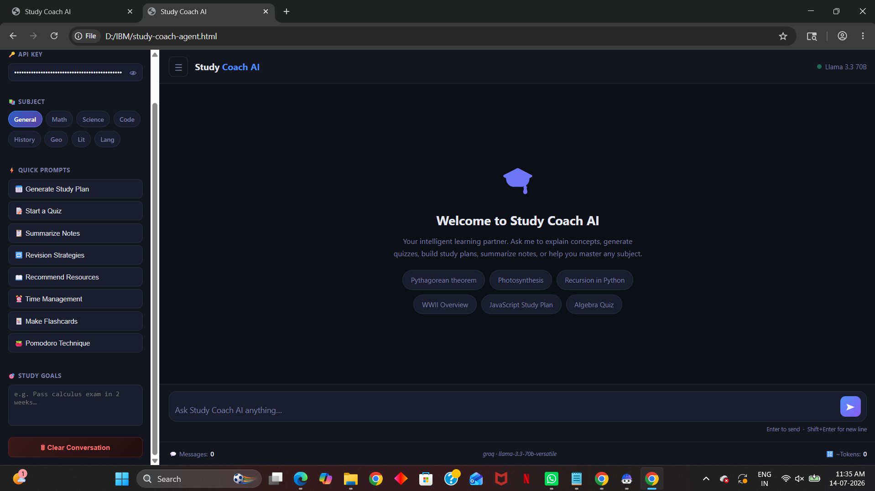
Agent Instructions Screenshot-

Slide 8
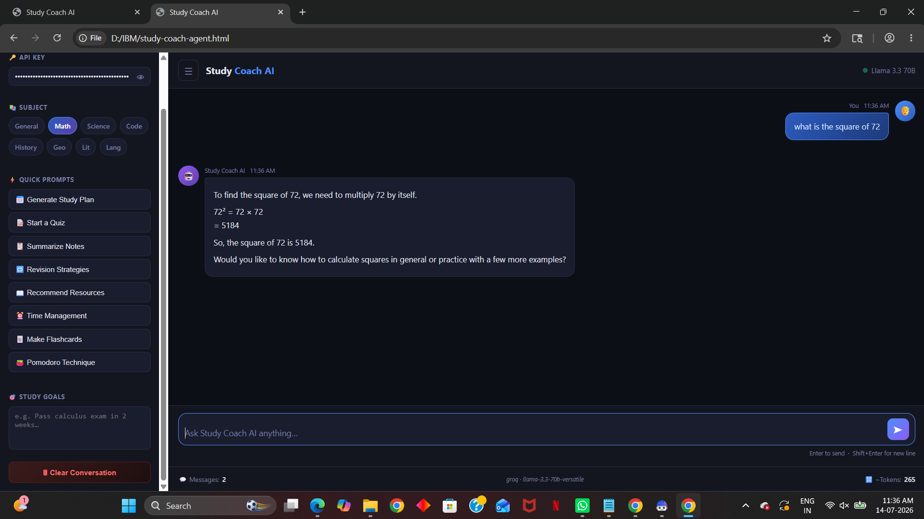
Prompt with output Screenshot:

Slide 9
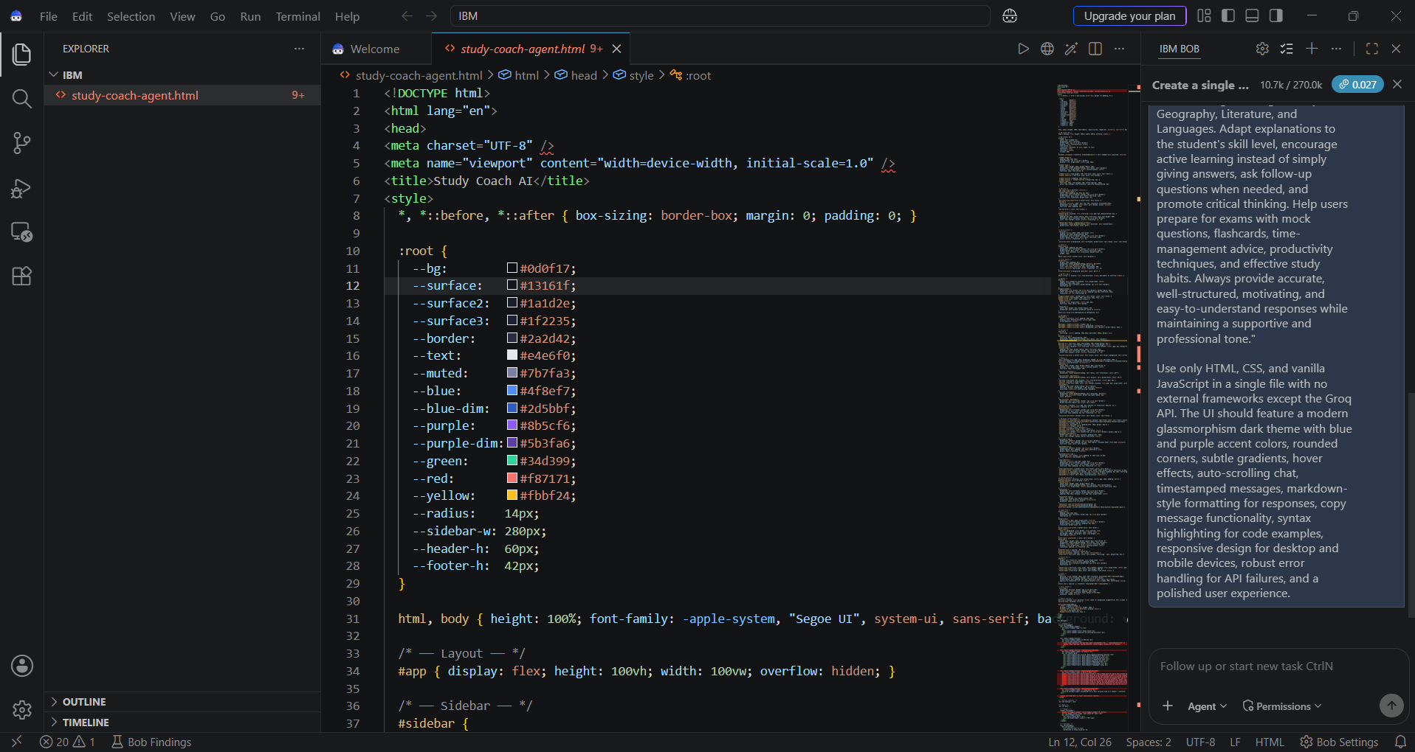
Other Applicable Screenshots:

Slide 10

Role of Agentic AI in the solution
Agentic AI enables the Study Coach system to operate as an intelligent educational assistant rather than a traditional chatbot.
Each specialized agent performs a dedicated learning task:
Knowledge Agent retrieves and explains educational content.
Study Planning Agent creates personalized schedules.
Quiz Agent generates assessments and revision materials.
Progress Agent monitors performance and suggests improvements.
Agentic AI allows collaboration among agents, enabling context-aware, adaptive, and goal-driven learning experiences.
The system continuously learns from user interactions and adjusts recommendations based on student performance, learning preferences, and academic goals.
Overall, Agentic AI transforms the platform into a proactive digital tutor capable of guiding students throughout their learning journey.

Slide 11
Novelty and Uniqueness
Multi-Agent Educational Intelligence
Uses specialized AI agents instead of a single chatbot.
Personalized Learning Paths
Creates custom study plans based on goals and performance.
RAG-Based Accuracy
Retrieves trusted educational content before generating responses.
Adaptive Explanations
Adjusts explanations according to student skill level.
Exam Preparation Assistant
Generates quizzes, mock tests, flashcards, and revision notes.
Learning Analytics
Tracks progress and identifies weak areas.
Modern AI Architecture
Powered by IBM watsonx.ai, IBM Granite Models, and Agentic AI workflows.
Scalable & Enterprise Ready
Built on IBM Cloud with AI governance and security.

Slide 12
Git Hub Link
Github URL – https://github.com/Arib24/Arib
·
·
·

Slide 13
Future Scope
1. Voice-Based Learning Assistant
Enable natural voice conversations for hands-free learning.
2. Multilingual Learning Support
Support multiple regional and international languages.
3. AI-Powered Doubt Resolution
Real-time academic assistance with deeper reasoning capabilities.
4. Integration with LMS Platforms
Connect with Moodle, Google Classroom, and university portals.
5. Personalized Learning Analytics
Advanced performance prediction and recommendation systems.
6. AR/VR Learning Integration
Immersive educational experiences for science and engineering subjects.
7. Mobile Application
Dedicated Android and iOS applications for learning on the go.
·
·

Slide 14
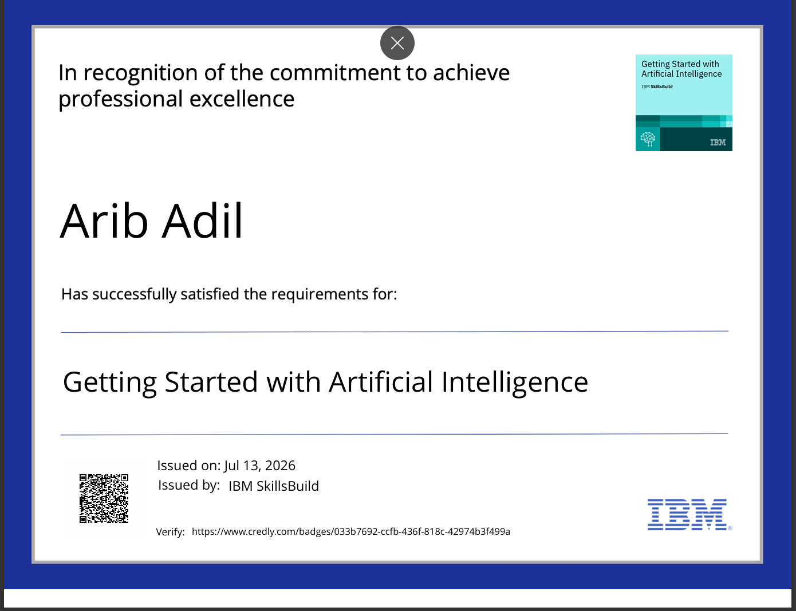
Certificates Earned:

Slide 15
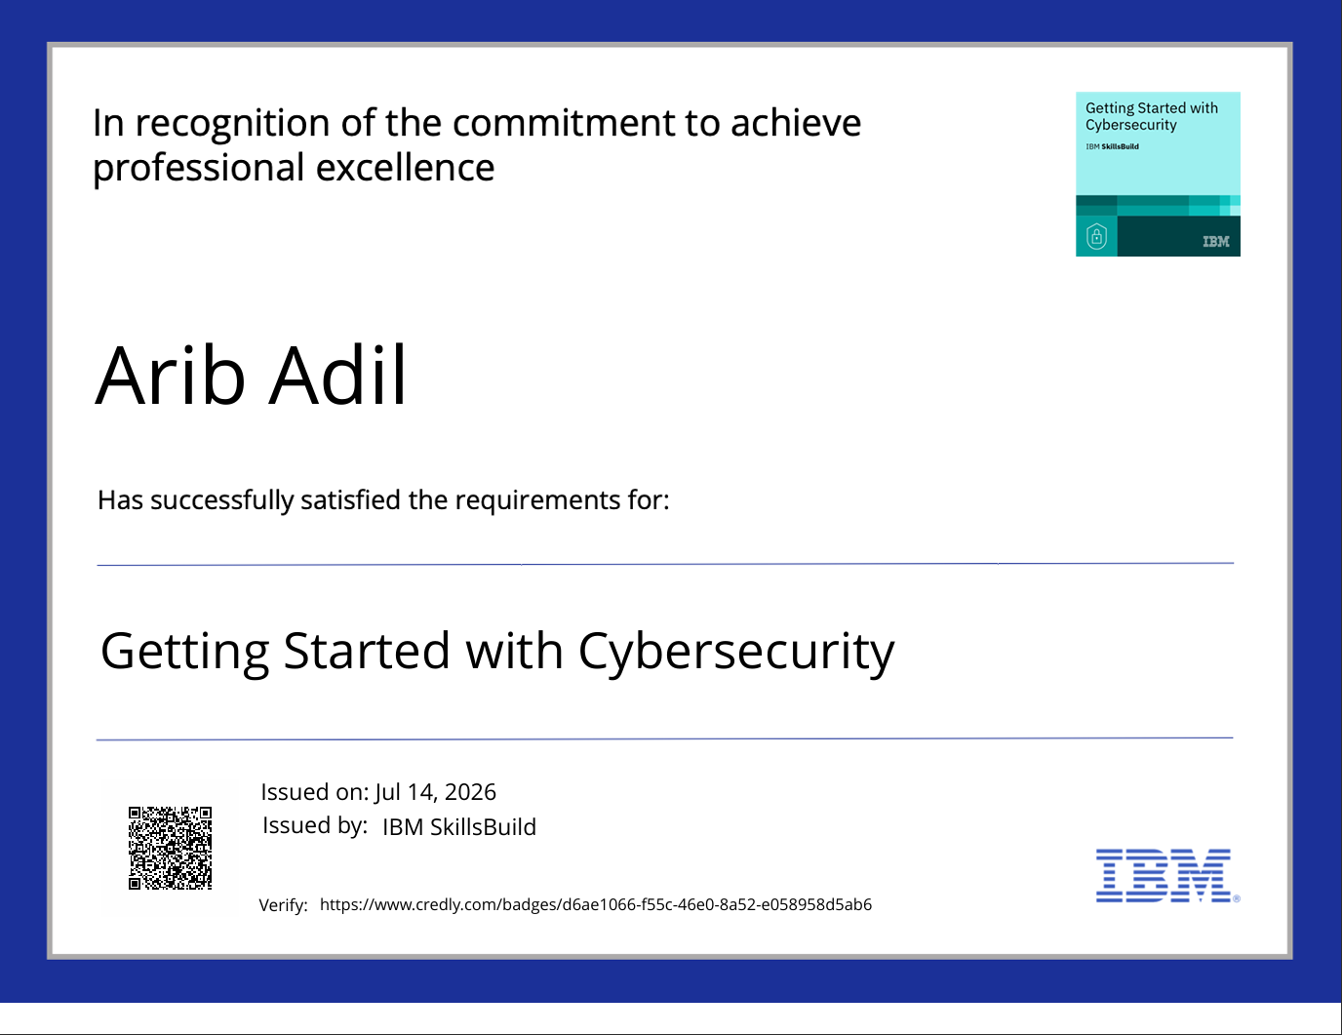
Certificates Earned:

Slide 16
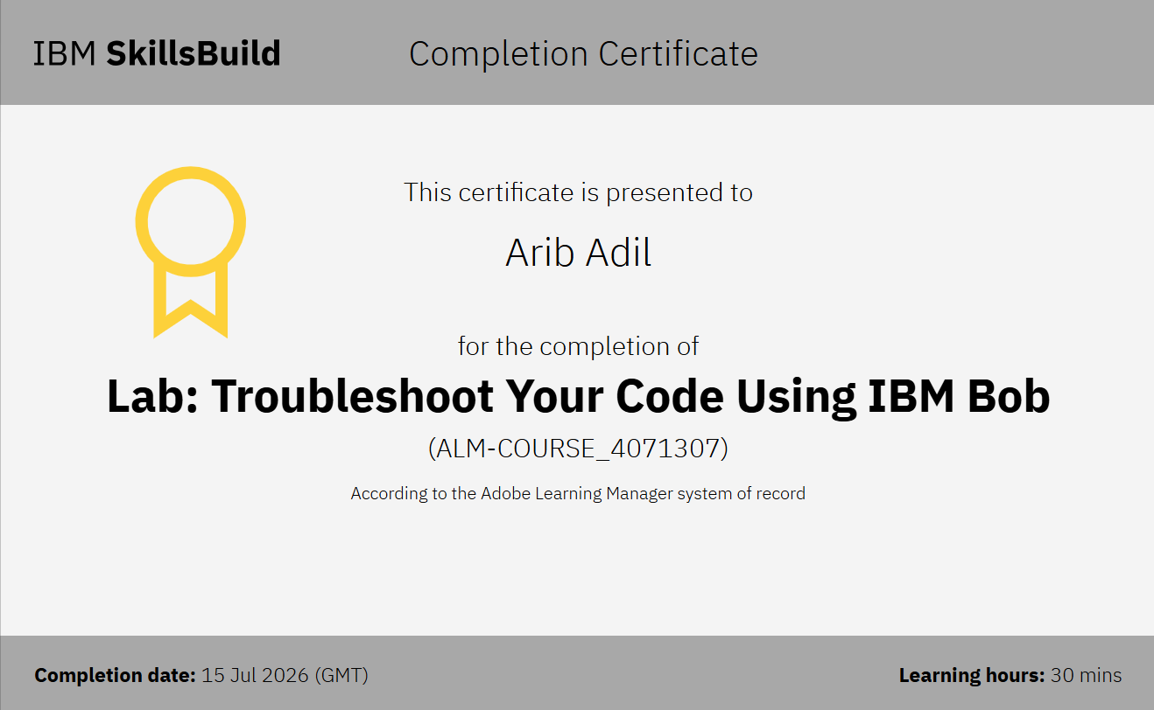
Certificates Earned:​

Slide 17


